Slide 1
Sentinel for Terraform Workshop (v4) https://storage.googleapis.com/instruqt-hashicorp-tracks/sentinel-shared/Sentinel-for-Terraform-v4.pptx
Roger Berlind
Global Technology Specialist
HashiCorp
Notes:
These slides are intended to accompany the Sentinel for Terraform v4 workshop
You can follow along at https://storage.googleapis.com/instruqt-hashicorp-tracks/sentinel-shared/Sentinel-for-Terraform-v4.pptx
They should be used with these tracks:
Sentinel CLI Basics
Sentinel for Terraform v4

Slide 2
Single Session Workshop Agenda
Sentinel in Terraform Cloud (TFC) and Terraform Enterprise (TFE)
The Sentinel Language
Lab Challenge 1: Using the Sentinel CLI
Lab Challenge 2: Applying and Testing a Policy with the CLI
The Evolution of Terraform Sentinel Policies
Writing Sentinel Policies and Testing them with the Sentinel CLI
Lab Exercises 1-2: Write and Test Your First Policies
Using Sentinel in Terraform Cloud
Lab Exercises 3-5: Write and Test More Policies
Advanced Techniques
Extra Credit Challenge
Notes:
In addition to learning about the topics in the agenda, you will be able to try your hand at writing and testing some Sentinel policies in a lab environment.
This presentation and the exercises are based on the Writing and Testing Sentinel Policies for Terraform guide: https://storage.googleapis.com/instruqt-hashicorp-tracks/sentinel-shared/WritingAndTestingSentinelPoliciesForTerraform-v3.0.pdf

Slide 3
Two Session Workshop Agenda
First Session:
Sentinel in Terraform Cloud (TFC) and Terraform Enterprise (TFE)
The Sentinel Language
Lab Challenge 1: Using the Sentinel CLI
Lab Challenge 2: Applying and Testing a Policy with the CLI
The Evolution of Terraform Sentinel Policies
Writing Sentinel Policies and Testing them with the Sentinel CLI
Using Sentinel in Terraform Cloud
Second Session
Advanced Techniques
Lab Exercises 1-2: Write and Test Your First Policies
Lab Exercises 3-5: Write and Test More Policies
Extra Credit Challenge
Notes:
In addition to learning about the topics in the agenda, you will be able to try your hand at writing and testing some Sentinel policies in a lab environment.
This presentation and the exercises are based on the Writing and Testing Sentinel Policies for Terraform guide: https://storage.googleapis.com/instruqt-hashicorp-tracks/sentinel-shared/WritingAndTestingSentinelPoliciesForTerraform-v3.0.pdf

Slide 4
Sentinel in Terraform Cloud and Terraform Enterprise
Notes:
Let's talk about Sentinel and how it fits into Terraform Cloud and Terraform Enterprise.
We'll also discuss how customers are using Sentinel in TFC and TFE.

Slide 5
What is Sentinel?
HashiCorp's Sentinel is a framework for implementing governance policies as code in the same way that Terraform implements infrastructure as code.
It includes its own language and is embedded in HashiCorp's enterprise products.
Using Sentinel ensures that your governance policies are actually being checked rather than just being listed in a spreadsheet.
It supports fine-grained policies that use conditional logic.
It includes a CLI that allows you to test policies.
Notes:
Sentinel is a framework for implementing governance policies as code
It has its own language
It has a CLI for testing and running policies

Slide 6
Terraform Cloud and Terraform Enterprise
Terraform Cloud (TFC) includes the following advanced functionality that makes it easier for teams and organizations to use Terraform:
A User Interface
Workspace Management
Team Management
State Management
Secure Variable Management
Remote Runs and State
VCS Integrations
HTTP/JSON API
Private Module Registry
Configuration Editor
Sentinel (policy as code)
SSO via SAML Integration
Audit Logging
Customers can install Terraform Enterprise (TFE) servers to self-host TFC in their own cloud virtual private networks or in their data centers.
Notes:
Let's level set about Terraform Cloud and Terraform Enterprise
Note that Terraform Cloud (TFC) refers both to the actual application used and the implementation hosted by HashiCorp at app.terraform.io.
Since TFE uses the TFC application, we will mostly just talk about TFC.
But anything we say about TFC is true of TFE too except when we discuss very new features that have been released to TFC.
But those new features generally end up in TFE within 4-6 weeks.

Slide 7
Where is Sentinel Used in Terraform?
Sentinel policies are checked between the standard plan and apply steps of Terraform runs.
Policies have different enforcement levels.
Violations prevent runs from being applied unless a user with sufficient authority overrides them.
Sentinel policies can evaluate the attributes (arguments and exported attributes) of existing and new resources based on information from the current run:
the plan, the configuration, the current state, and other run data including cost estimates
This ensures that resources comply with all policies before they are provisioned.
Notes:
Let's talk about where Sentinel is used in TFC and TFE.
It is run between the plan and the apply of a run.
If cost estimates are enabled for a workspace, the Sentinel policies are checked after the cost estimates are collected.
"Arguments" are the inputs to Terraform resources and data sources.
Each resource and data source also exports certain attributes that are computed during the apply. These are called "exported attributes".
But since the arguments or a resource are also exported, it is common to use "attributes" to refer to the union of a resource's arguments and exported attributes.

Slide 8
How Customers are Using Sentinel in Terraform
HashiCorp customers are using Sentinel to implement governance policies like the following in Terraform Cloud/Enterprise:
Enforce security standards:
Require all S3 buckets use the private ACL and be encrypted by KMS.
Restrict which roles the AWS provider can assume.
Prohibit specific resources, data sources, providers, or provisioners.
Avoid excessive costs:
Limit the sizes of VMs and Kubernetes clusters in public clouds.
Limit the monthly spend of each Terraform workspace.
Enforce mandatory tags on resources provisioned by Terraform.
Mandate that all modules come from a Private Module Registry.
Enforce specific Terraform coding conventions.
Notes:
Let's talk about some use cases for Sentinel in TFC and TFE.

Slide 9
Sentinel Policy Sets and Policies
Policy Sets are groups of Sentinel Polices (and optionally Sentinel Modules) which can be enforced on all workspaces or only on selected workspaces within one or more organizations.
They are usually created in VCS repositories and then registered with organizations using the Terraform Cloud UI or API.
But it is also possible to use non-VCS-backed policy sets managed with the TFC API.
They can be restricted to a specific VCS branch and to a specific path within it, allowing multiple policy sets to exist in a single repository.
Additionally, Parameters can be added to policy sets allowing the secure introduction of credentials needed by API endpoints invoked with the Sentinel HTTP import.
Notes:
Sentinel policies are added to TFC/TFE organizations using Policy Sets.
They are usually created in VCS repositories, but it is also possible to use non-VCS-backed policy sets and upload files to them with the TFC/E Policy Set Versions API endpoint.
Non-VCS-backed policy sets can load a tar file including a sentinel.hcl policy set definition file, policies, and Sentinel modules.
See https://github.com/hashicorp/terraform-guides/blob/master/operations/sentinel-policies-scripts/create-policy-set-version.sh
The sentinel.hcl file can also refer to remote Sentinel modules and policies in VCS repositories.
Parameters can be added to both VCS-backed and non-VCS-backed policy sets, but not for the latter if you use the TFE provider to create the policy set.

Slide 10
Benefits of Storing Policies in VCS
All the standard VCS benefits including version history, change control, and collaboration
+
Sharing policies across multiple TFC/E organizations without having to edit them multiple times
Ensuring modified policies pass your Sentinel CLI test cases before they are merged
Notes:
What are the benefits of storing your policies in VCS repos?
By using tools like GitHub Actions, you can test changes to policies with the Sentinel CLI every time they are changed.

Slide 11
Sentinel Policy Enforcement Levels
Advisory
Only logs violations
Soft Mandatory
Can be overridden by authorized users:
Members of the owners team
Members of teams with the "Policies Override" permission
Hard Mandatory
Cannot be overridden by anyone
Customers often create new Sentinel policies as Advisory, then transition to Soft Mandatory, and eventually to Hard Mandatory.
This gives Terraform coders time to adapt and modify their code.
Notes:
There are 3 enforcement levels for Sentinel policies.
Users with sufficient permissions can override soft mandatory policies.

Slide 12
Types of Terraform Sentinel Policies
There are essentially four types of Terraform Sentinel policies corresponding to the 4 Terraform Sentinel imports:
Policies can use the tfplan/v2 import to restrict specific attributes of specific resources and data sources in the current Terraform plan.
Policies can use the tfconfig/v2 import to restrict the configuration of Terraform modules, variables, resources, data sources, providers, provisioners, and outputs.
Policies can use the tfstate/v2 import to check whether previously provisioned resources or data sources have attributes with values that are no longer allowed.
Policies can use the tfrun import to check workspace and run metadata and whether cost estimates for planned resources are within limits.
Some policies might use more than one of these imports.
Notes:
There are essentially four types of Sentinel policies, corresponding to the 4 Terraform Sentinel imports (which go beyond the 11 standard imports provided by Sentinel itself).
In this version of the workshop, we are using the v2 tfplan, tfconfig, and tfstate imports.
While we will be using the Terraform Sentinel v2 imports, we usually drop "/v2" except in actual Sentinel code.
There is no v2 version of the simpler tfrun import because changes were not needed to give better compatibility with Terraform's data structures in versions 0.12 and higher .
Remember that "attributes" here refers to both "arguments" and "exported attributes".

Slide 13
The v2 Versions of the Terraform Sentinel Imports
The v2 versions of three Terraform Sentinel imports (tfplan, tfstate, and tfconfig) are aligned more closely with Terraform's native data structures in versions 0.12 and higher.
This makes the v2 imports easier to use than the v1 imports.
Additionally, since resource instances are stored in a single flat map that spans across all Terraform modules and resource types, it is much easier to find all resources instances of a specific type or a sub-collection of them.
However, the v2 imports can only be used with Terraform 0.12 and higher.
Notes:
Sentinel has some builtin functions that you can use in any policy.

Slide 14
What Sentinel Does Not Do in Terraform
Continually check infrastructure to validate compliance
But policies could be triggered periodically to do this.
Remove existing resources that violate policies
Ensure that resource attributes are actually valid
For instance, Sentinel can validate that a KMS key is specified for an S3 bucket, but not that it is a valid key.
However, Terraform checks attribute validity when applying plans.
Analyze the executable contents of VMs and containers
Limit runtime actions of deployed applications
Notes:
Sentinel does not everything under the sun.

Slide 15

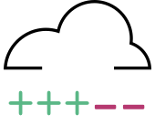
How Terraform Works Without Sentinel
VCS
Terraform
plan & apply
Infrastructure
Notes:
Here is how Terraform works without Sentinel.

Slide 16

How Terraform Works With Sentinel
VCS
Terraform
Cloud
Workspace
plan
Sentinel
Policy
Checks
apply
Infrastructure
If cost estimates are enabled, they run right after the plan.
Notes:
Here is how Terraform works with Sentinel.
Note that if cost estimates are enabled for the workspace, they will run right after the plan.

Slide 17
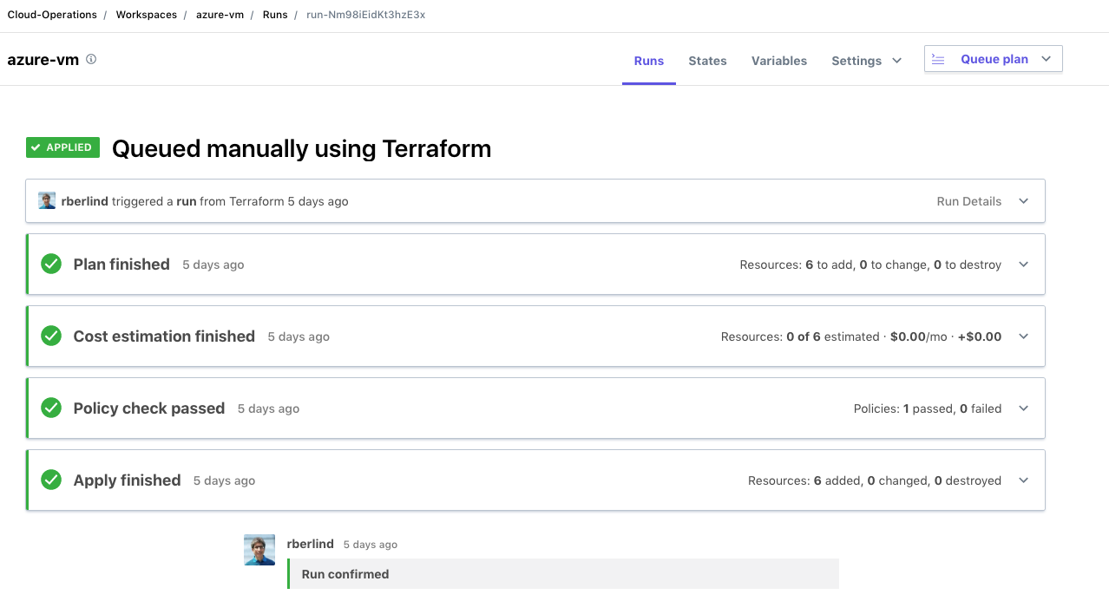
All Policy Checks Passed
Notes:
A screenshot from TFC showing that all policy checks passed for a run.
Note that output from policies can be viewed in two formats: text and json.

Slide 18
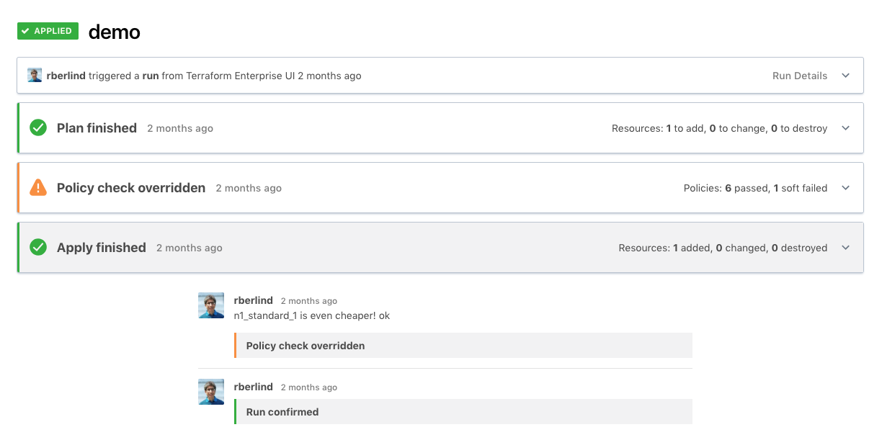
A Soft Mandatory Policy Check Was Overridden
Notes:
A screenshot from TFC showing a soft mandatory policy check that failed but was then overridden.

Slide 19
Sentinel Imports in Terraform
The tfplan/v2 gives data generated from Terraform plans.
https://www.terraform.io/docs/cloud/sentinel/import/tfplan-v2.html
The tfconfig/v2 import gives data about the Terraform configuration.
https://www.terraform.io/docs/cloud/sentinel/import/tfconfig-v2.html
The tfstate/v2 import gives data about the current state of a workspace.
https://www.terraform.io/docs/cloud/sentinel/import/tfstate-v2.html
The tfrun import provides metadata for Terraform runs and their workspaces as well as cost estimate data. (There is no v2 version of it.)
https://www.terraform.io/docs/cloud/sentinel/import/tfrun.html
Notes:
This is a good point to discuss the Terraform-specific Sentinel imports.
Terraform Cloud/Enterprise adds 4 Sentinel imports beyond the standard ones.
This version of the workshop uses the v2 versions of the tfplan, tfconfig, and tfstate imports.
The v2 versions are more closely aligned to Terraform's internal data structures for versions 0.12 and higher.
There is only 1 version of the tfrun import.

Slide 20
Sentinel Mocks in Terraform
Sentinel Mocks simulate the data that is made available to the Terraform Sentinel imports from Terraform plans.
They can be generated from recent plans using the Terraform Cloud UI and API.
They can also be copied and edited to simulate various combinations of resource and data source attributes.
They enable testing of Terraform Sentinel policies with the Sentinel CLI.
Using the Sentinel CLI with mocks speeds up development of new policies since additional plans do not need to be run.
Notes:
You can generate Sentinel mocks from Terraform plans in TFC/TFE.
You can then use these mocks when testing policies with the Sentinel CLI

Slide 21
Useful Sentinel Documentation
Main Sentinel Docs:
https://docs.hashicorp.com/sentinel
Terraform Cloud Sentinel Docs:
https://www.terraform.io/docs/cloud/sentinel/index.html
GitHub Repository with Sample Sentinel Policies for AWS, Azure, GCP, and VMware as well as useful common functions in modules:
https://github.com/hashicorp/terraform-sentinel-policies
Guide to Writing and Testing Sentinel Policies in Terraform:
WritingAndTestingSentinelPoliciesForTerraform-v3.0.pdf
Notes:
This slide gives some useful links that will help you learn how to use Sentinel in TFC and TFE and how to write your own Sentinel policies.
The instructor should show these links to the students.

Slide 22
Sentinel Language
Notes:
Let's spend some time discussing the Sentinel language.

Slide 23
Key Sentinel Language Constructs (1)
Boolean Expressions: Evaluate to true, false, or undefined.
They use logical, comparison, set, and other Operators.
(5*2 == 10) and (7 in [ 2, 3, 5, 7, 11, 13, 17, 19])
Rules: Evaluate a single expression which could be the result of calling a single function.
Main Rule: Every Sentinel policy must have a rule called main.
The result of a policy is the value returned by its main rule.
Statements: Execute procedural logic.
Functions: Execute various statements and return a value.
Variables: Store values for use by rules and functions.
Parameters: Accept inputs passed to policies.
Notes:
Note that each rule can only contain a single expression. Rules cannot include statements, for loops, or if/else statements, but a rule could invoke a single function.
If you need to do complex processing that cannot be done with a single expression, define a function and call that function from your rule.
Rules that return a boolean value can use the "all" and "any" expressions since these are rendered as chained "and" and "or" logical operators.

Slide 24
Key Sentinel Language Constructs (2)
Types: boolean, integer, float, string, list, map
A List is a collection of zero or more items
A Map is a collection of zero or more key/value pairs
Operators: Arithmetic, Logical, Comparison, Set, Matches, Else
Assignments: Set the value of variables.
If/Else and Case Statements: Specify conditional execution of different logic within a function.
For Loops: Repeat statements while iterating over a map or list.
Frequently used inside functions
break and continue statements can alter loop execution.
The Filter quantifier expression that returns a subset of a collection.
Imports: Reusable libraries of Sentinel functions.
Notes:
The types.type_of() function from the types import gives the type of null as "null", so null can also be viewed as a type.
The types.type_of(undefined) gives "undefined", so undefined can also be viewed as a type.
Sentinel imports can now be written in Go or in Sentinel itself.
While Sentinel itself supports creation of custom imports written in Go, those cannot currently be imported into TFC or TFE.
However, custom imports written in Sentinel are already usable in the Sentinel CLI, TFC, and TFE.

Slide 25
Sentinel Keywords
all
any
as
break
case
continue
else
filter
for
func
if
is
import
map
param
return
rule
when
Notes:
Sentinel has some keywords that should not be used as names of variables, functions, or rules.

Slide 26
Sentinel Pre-declared Identifiers
Constants:
false
true
null
undefined
Type Conversion Functions:
bool
float
int
string
Other Builtin Functions:
append
delete
error
keys
length
print
range
values
Notes:
Sentinel also has some pre-declared identifiers that should not be used as names of variables, functions, or rules.
Note that null and undefined are different. Some values in Sentinel structures are intentionally set to null. But undefined indicates that a value was missing.

Slide 27
Sentinel Numerical and Logical Operators
Arithmetic: +, -, *, /, and % (remainder)
p and q p and q must both be true
p or q at least one of them must be true
p xor q exactly one of them must be true
!p p is false
not p p is false
Notes:
Parentheses can be used to refine the processing in compound boolean expressions.
See https://docs.hashicorp.com/sentinel/language/boolexpr/#order-of-operations for the default order of operations.

Slide 28
Sentinel's Short-Circuit Logic
Sentinel applies Short-Circuit Logic for compound boolean expressions like p and q and (a and b) or c:
This means that Sentinel does not evaluate all conditions further to the right if it already knows the final answer.
So, if p is false, it does not evaluate q since p and q is already false.
If a and b are both true, it does not evaluate c since (a and b) or c is already true.
If a is false, it does not evaluate b since a and b is already false, but it does evaluate c since (a and b) or c could still be true or false, depending on the value of c.
Notes:
Sentinel uses short-circuit logic.
This means some conditions will not be evaluated.
It is important to understand when this might happen.

Slide 29
Sentinel Comparison Operators
== equal to
!= not equal to
< less than
<= less than or equal to
> greater than
>= greater than or equal to
is equal to
is not not equal to
Note that maps and lists are comparable!
Notes:
Here are Sentinel's comparison operators.

Slide 30
Sentinel Set Operators
Set operators can be applied to lists, maps and strings.
For strings, the set operators do substring inclusion
Examples for lists:
1 in [1, 2, 3] Means that 1 is in the list
[1, 2, 3] contains 2 Means that the list contains 2.
[] is empty Means that the collection is empty.
You can also use not in, not contains, and is not empty.
Notes:
Here are Sentinel's set operators.

Slide 31
The Sentinel Matches Operator
The matches operator tests if a string matches a regular expression.
Examples:
"test" matches "^te" # true
"1352" matches "[0-9]*" # true
"123A" matches "[0-9]*" # false
"xyz.com matches ".*\\.com" # true
The strings import can also be used to determine if a string has a specific prefix or suffix
Notes:
Sentinel also has a matches operator that can be used to do regex matching.
Useful regex constructs are "." to match any single character, ".*" to match 0 or more occurrences of any character, ".+" to match 1 or more occurrences of any character, "^" to match the beginning of a string, "$" to match the end of a string, "[]" to group characters, and "^" before a group to negate it. Special characters are escaped with "\\".
Note that Sentinel regex always needs "\\" instead of "\" so that Sentinel does not treat "\" as an escape character.
That is why the last regex example in the slide uses ".*\\.com" instead of the more usual ".*\.com".
The strings import can also be used to check prefixes and suffixes.

Slide 32
The Sentinel Else Operator
The else operator converts the undefined value to something else.
If a number is undefined, you might convert it to 0
(memory else 0) <= 2048
If a boolean is undefined, you might convert it to true or false.
(memory <= 2048) else false
If a list is undefined, you might convert it to the empty list, [].
keys(tfplan.resource_changes) else []
If a map is undefined, you might convert it to the empty map, {}.
allEC2Instances else {}
Note that the else operator does not affect null.
Notes:
Sentinel's else operator is very important since it helps you avoid the undefined value in your policies.

Slide 33
Sentinel For Loops
A Sentinel for loop iterates over a collection.
Each for loop uses the as keyword to define one or two iterator variables.
When iterating over a list, the first variable is assigned the index and the second variable is assigned the value.
If only one iterator variable is specified, it is assigned the value.
When iterating over a map, the first variable is assigned the key and the second variable is assigned the value.
If only one iterator variable is specified, it is assigned the key.
Notes:
The for loop is always used with the as keyword to declare iterator variables
See https://docs.hashicorp.com/sentinel/language/loops/#for-statements

Slide 34
Sentinel For Loop Examples
This example iterates over a list with one variable (for the values).
count = 0
for [1, 2, 3] as num {
count += num
}
The count will equal 6.
This example iterates over a map with two variables:
data = { "a": 12, "b": 32 }
for data as k, v {
sum += v
}
The sum will equal 44.
Notes:
The for loop is always used with the as keyword to declare iterator variables
When iterating over a list, only one iterator variable is used.
When iterating over a map, two are usually used, the first for the keys and the second for the values of the map.
If you only declare one iterator variable for a map, it will represent the values of the map.
See https://docs.hashicorp.com/sentinel/language/loops/#for-statements

Slide 35
The Sentinel all and any Expressions
The all and any quantifier expressions are are used like loops, but they are actually quantifier expressions that apply boolean expressions to lists and maps. They return true or false.
The all expression is a universal quantifier asserting that a boolean expression must be true for all items of a collection.
The any expression is an existential quantifier asserting that a boolean expression must be true for at least one item in a collection.
It used to be common to use all expressions in Sentinel rules, but it is better to use for loops in functions called before the main rule.
This allows your policies to report all violations in a single shot.
Notes:
We will often refer to all and any expressions as loops because that is how they behave.
In functions, you would use for loops instead of the all expression.
We highly recommend avoiding the use of rules with the all and any expressions because of Sentinel's short-circuit logic which causes them to stop processing as soon as they see a violation of a condition.
It is much better to use for loops in functions.

Slide 36
The Sentinel filter and map Expressions
The filter quantifier expression applies a boolean expression to each item in a list or map.
However, instead of returning true or false, it returns a sub-collection of the original collection consisting of those items for which the boolean expression was true.
The filter expression is useful with the Terraform Sentinel v2 imports since their collections were designed to be used with it.
The map quantifier expression returns a list of values, one for each item in the collection it is applied to.
It can be useful in Sentinel rules that want to return non-boolean values including maps and lists.
Notes:
The filter quantifier was added in Sentinel 0.14.0
The map quantifier was added in Sentinel 0.17.0

Slide 37
The Sentinel If/Else Conditional
This example tests if v is defined and equal to value:
if v else null is null {
print("The value", v, "was null or not defined")
} else if v is not value {
print(v, "is not equal to the required value", value)
} else {
print(v, "is the desired value", value)
}
Notes:
The for loop is always used with the as keyword to declare iterator variables
When iterating over a list, only one iterator variable is used.
When iterating over a map, two are usually used, the first for the keys and the second for the values of the map.
If you only declare one iterator variable for a map, it will represent the values of the map.
See https://docs.hashicorp.com/sentinel/language/loops/#for-statements

Slide 38
The Sentinel Case Conditional
This example does different processing for different days:
case day {
when "Saturday", "Sunday":
print("Sorry, we are closed.")
else:
print("We are open from 9am to 6pm.")
}
Notes:
The for loop is always used with the as keyword to declare iterator variables
When iterating over a list, only one iterator variable is used.
When iterating over a map, two are usually used, the first for the keys and the second for the values of the map.
If you only declare one iterator variable for a map, it will represent the values of the map.
See https://docs.hashicorp.com/sentinel/language/loops/#for-statements

Slide 39
Standard Sentinel Imports
Beyond the TFC Sentinel imports we already mentioned (tfplan, tfconfig, tfstate, and tfrun), you can also use these Standard Imports:
base64
decimal
http
json
runtime
sockaddr
strings
time
types
units
version
Notes:
See https://docs.hashicorp.com/sentinel/imports
The http import currently only supports the HTTP GET operation against API endpoints that return JSON documents.
It is possible to send data to an API endpoint with the http import using headers or URL parameters.
See https://docs.hashicorp.com/sentinel/imports/http

Slide 40
Common Operations of the Standard Imports
Check if a string has a prefix: strings.has_prefix(s, prefix)
Check if a string has a suffix: strings.has_suffix(s, suffix)
Check the type of a Sentinel object: types.type_of(obj)
Make external calls to API endpoints:
response = http.get("https://example.hashicorp.com")
Convert a JSON object to a Sentinel structure:
json.unmarshal(response.body)
Notes:
See https://docs.hashicorp.com/sentinel/imports
The http import currently only supports the HTTP GET operation against API endpoints that return JSON documents.
It is possible to send data to an API endpoint with the http import using headers or URL parameters.
See https://docs.hashicorp.com/sentinel/imports/http

Slide 41
Sentinel Functions
A Sentinel Function is declared with the func keyword.
find_resources = func(resource_type) {
# Do something and use the parameter
return true
}
Each function has a name such as find_resources.
Each function can have zero or more parameters.
The function above has the single parameter, resource_type
Every function must return a value such as true.
A call to this function could look like:
s3_buckets = find_resources("aws_s3_bucket")
Notes:
Functions are declared with the func keyword.
They all have a name.
They can also have parameters.
They must return a value.
See https://docs.hashicorp.com/sentinel/language/functions for more details.
We'll see calls to functions in policy examples.

Slide 42
Builtin Functions
Sentinel includes some useful Builtin Functions:
append Appends a value to the end of a list
delete Deletes an element from a map
error Immediately exit with an error message
keys Returns the keys of a map
length Returns the length of a collection or string
print Prints what you tell it to. Always returns true.
range Returns a list of numbers in a range.
values Returns the values of a map.
There are also Type Conversion functions, bool, float, int, and string, which convert other types to their type.
Notes:
Sentinel has some builtin functions that you can use in any policy.

Slide 43
Sentinel Modules
A Sentinel Module defines Sentinel functions and rules in a file that can be used by Sentinel policies with a single import statement.
This avoids the need to paste the functions into every policy that calls them, improving the reusability of Sentinel functions.
Sentinel modules are registered in Sentinel CLI configuration files and in TFC/TFE policy set configuration files.
The terraform-sentinel-policies repository includes 8 modules:
tfplan-functions, tfstate-functions, tfconfig-functions, tfrun-functions, aws-functions, azure-functions, gcp-functions, and registry-functions.
Each function is documented in a separate Markdown file.
Note that these are NOT standard functions.
Notes:
Sentinel modules allow for the reuse of Sentinel functions and rules.
They are registered in Sentinel CLI configuration files and in TFC/TFE policy set configuration files.

Slide 44
Workshop Challenge 1: Using the Sentinel CLI
Notes:
Now we will do the first workshop challenge on the Instruqt platform

Slide 45
Challenge 1: Using the Sentinel CLI
The hands-on lab exercises of this workshop are done in an interactive learning platform, Instruqt, that HashiCorp has standardized on for workshops.
For this workshop, please use links provided by your instructor for these tracks:
Sentinel CLI Basics
Sentinel for Terraform v4
When this workshop is split into two sessions (as is often the case), the first track will be used during the first session and the second track will be used during the second session.
In the first challenge of the first track, you'll learn how to run Sentinel CLI commands.
Notes:
The workshop exercises leverage the Instruqt platform and make solving the exercises much easier.
We recommend you not start the second track until the second session when the workshop is delivered in two sessions.

Slide 46
Instruqt Basics
The Instruqt platform organizes training content into Tracks consisting of multiple Challenges that must be solved in a specific order.
Each track launches one or more VMs and/or Docker containers and exposes terminals, file editors, and user interfaces on Tabs.
Information about each challenge is displayed on Note screens while it is loading. A Start Button will be shown when the challenge is ready.
Detailed instructions are listed in an Assignment to the right of the tabs.
You can click the Check Button to verify if you have completed the assignment. If you have, you will advance to the next challenge. Otherwise, you will be given a hint about what to do next.
We recommend you review Instruqt's own tutorial track for more details:
https://play.instruqt.com/instruqt/tracks/getting-started-with-instruqt
Notes:
Here are some basics about Instruqt.
You might also want to spend 5 minutes reviewing Instruqt's own tutorial track.

Slide 47
Workshop Challenge 2: Applying and Testing Policies
Notes:
Now we will do the first two workshop challenges on the Instruqt platform

Slide 48
Challenge 2: Applying and Testing Policies
In the second challenge, you'll learn how to apply and test a simple Sentinel policy with the Sentinel CLI.
This will include learning about Sentinel test cases.
Please continue in your running instance of the Sentinel CLI Basics track by clicking the green Check button.
If it has expired, please start it again, quickly run the commands in the first challenge, and then click the green Check button to advanced to the second challenge.
Notes:
The workshop exercises leverage the Instruqt platform and make solving the exercises much easier.
We are doing the second challenge in Sentinel CLI Basics

Slide 49
The Evolution of Sentinel Policies
Notes:
Now we will do the first two workshop challenges on the Instruqt platform

Slide 50
The First-Generation Policies
The first-generation policies were written in late 2018 and used the original Terraform Sentinel v1 imports.
They had several short-comings, including the following:
Most of the policies did not print violation messages for resources that violated them.
They stopped evaluating conditions as soon as a single resource instance violated them.
They failed when resources that were being destroyed violated conditions.
Their use of default Sentinel output was overly verbose.
Notes:
The first-generation policies had several limitations.

Slide 51
The Second-Generation Policies
The second-generation policies were written in 2019 and used the original Terraform Sentinel v1 imports:
They made the following improvements:
They offloaded most processing from rules into some common parameterized functions.
Those common functions were written in a way that caused all violations of all conditions to be reported.
They printed out the full address of each resource instance that did violate a policy.
By using a single main rule, they suppressed most of Sentinel’s default, overly verbose output.
They skipped resources that were being destroyed but not recreated.
Notes:
The second-generation policies made many improvements.

Slide 52
The New Third-Generation Policies
The new third-generation policies were written in the spring of 2020 and use the new Terraform Sentinel v2 imports and Sentinel modules.
They have the following advantages:
Their use of the v2 imports and the Sentinel filter expression makes it easier to restrict policies to specific operations performed by Terraform.
The common functions defined in Sentinel modules do not need to be pasted into policies that use them.
Most of the policies do not have any for loops of if/else conditionals. This makes the policies easier to understand and copy.
They can evaluate the value of any attribute of any resource or data source, even those that are deeply nested.
However, since they do use the v2 imports, they can only be used with Terraform 0.12 and higher.
Notes:
The workshop exercises leverage the Instruqt platform and make solving the exercises much easier.

Slide 53
Some Prototypical Third-Generation Policies
I'll review four prototypical third-generation Sentinel policies in order of increasing sophistication:
restrict-ec2-instance-type.sentinel (AWS)
restrict-vm-cpu-and-memory.sentinel (VMware)
restrict-vm-disk-size.sentinel (VMware)
restrict-publishers-of-current-vms.sentinel (Azure)
Notes:
This slide gives the basic 8 step methodology of writing and testing Sentinel policies from the Writing and Testing Sentinel Policies for Terraform guide.
We will focus on 5-7 in this workshop.

Slide 54
Writing and Testing Sentinel Policies for Terraform
Notes:
Now let's walk through the basic 8 step methodology of the Writing and Testing Sentinel Policies for Terraform guide.

Slide 55
Basic Methodology for Restricting Resources
The Eight Steps of the recommended methodology are:
Create a Terraform configuration that creates the resource.
Create a workspace that uses your Terraform configuration.
Run a plan against the workspace.
Generate mocks against the plan in the TFC UI.
Write a new Sentinel policy.
Create test cases and test your policy with the Sentinel CLI.
Revise your policy and test cases until the latter all pass.
Deploy your policy to a TFC organization.
Notes:
This slide gives the basic 8 step methodology of writing and testing Sentinel policies from the Writing and Testing Sentinel Policies for Terraform guide.
We will focus on 5-7 in this workshop.

Slide 56
Create a Terraform Configuration
Create a Terraform configuration that creates at least one instance of the resource your policy will restrict.
Include a main.tf file to create the resource.
Include a backend.tf file to configure the remote backend (if you would like to use the remote backend).
Use variables to set the values of the attributes being restricted.
Create more than one instance of the resource to test your policy's ability to correctly handle some that pass and some that fail.
Notes:
Step 1 is to create a Terraform configuration that uses the resource that you want to restrict.

Slide 57
Create a Terraform Configuration: main.tf
variable "ami_id" {
default = "ami-2e1ef954"
}
variable "instance_type" {
default = "t2.micro"
}
resource "aws_instance" "ubuntu" {
count = 2
ami = "${var.ami_id}"
instance_type = "${var.instance_type}"
}
Notes:
We're only showing part of a Terraform configuration here.
A more complete version of this is at https://github.com/hashicorp/terraform-guides/tree/master/infrastructure-as-code/aws-ec2-instance

Slide 58
Terraform Terminology for Resources
Let's consider the declaration of the resource from the last slide.
resource "aws_instance" "ubuntu" {
count = 2
ami = "${var.ami_id}"
instance_type = "${var.instance_type}"
}
In this case, "aws_instance" is the Type of the resource while "ubuntu" is its Name.
Each occurrence of a resource is referred to as a Resource Instance.
This Terraform code will create two Instances of the resource since count was set to 2.
Notes:
Note that in this case, "aws_instance" is the type if the resource while "ubuntu" is the name of the resource.
Each occurrence of a specific resource provisioned by Terraform is referred to as a resource instance.
This Terraform code will create two instances of the resource named "ubuntu" of type "aws_instance".

Slide 59
Create a Terraform Configuration: backend.tf
terraform {
backend "remote" {
hostname = "<your_TFE_server>"
organization = "<your_org>"
workspaces {
name = "<your_workspace>"
}
}
}
Notes:
Be sure to set valid values for hostname, organization, and the name of your workspace in your backend.tf file.
If you're using HashiCorp's hosted Terraform Cloud implementation, set hostname to "app.terraform.io" and set organization to your organization on that server.

Slide 60
Generate a User API Token
In order to use the remote backend against a TFC/TFE server, you need to generate a User API Token for yourself.
You then need to list the token in your Terraform CLI configuration file.
On a Mac or Linux machine, this will be the .terraformrc file in your home directory.
On a Windows machine, this will be the terraform.rc file in your %APPDATA% directory.
The token should be added in a section like this:
credentials "app.terraform.io" {
token = "<token>"
}
Notes:
You'll need to generate a user API token if using the Terraform CLI with the remote backend.

Slide 61
Create a TFC or TFE Workspace
If you trigger your plan with the remote backend, you do not need to set up a VCS connection.
Click "CLI-driven workflow" when creating your workspace when prompted to connect to a version control provider.
You still need to add environment variables such as cloud credentials to your workspace since local ones are not sent to the server.
Several tools can push Terraform and environment variables:
set-variables.sh
tf-helper (tfh)
Notes:
Step 2 is to create a Terraform Cloud or Terraform Enterprise workspace in which you can run a plan against your Terraform configuration.

Slide 62
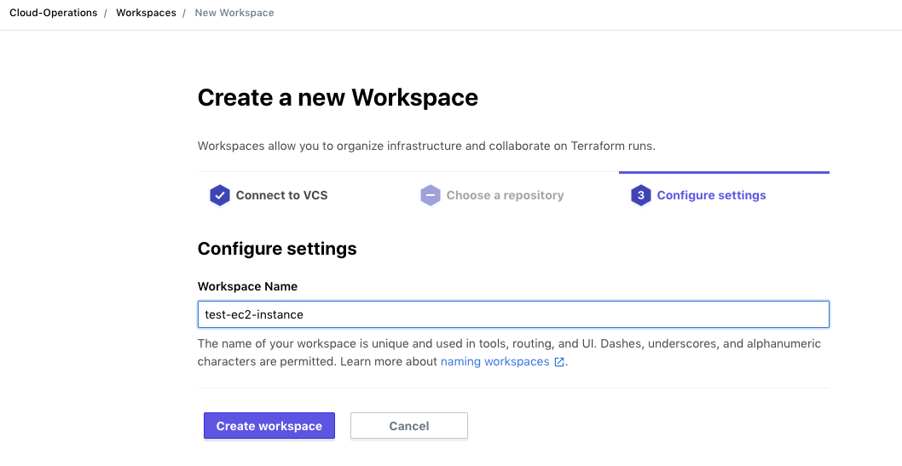
Create a Workspace in the TFC/TFE UI
Notes:
This screenshot shows creation of a workspace in the TFC UI.

Slide 63
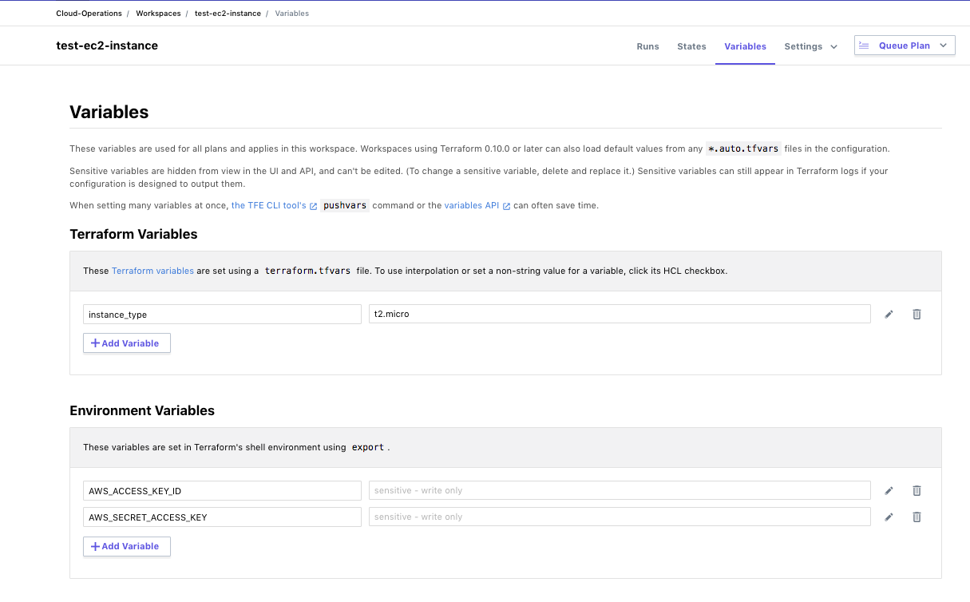
Set Variables in Your Workspace
Notes:
After creating a workspace, you will usually have to set some variables in it.
This could include both Terraform and Environment variables.
Note that environment variables cannot contain line breaks.
This is important when setting the GOOGLE_CREDENTIALS environment variable to a service account credentials file which is a JSON document; you need to strip out all the line breaks.

Slide 64
Run a Plan and Generate Mocks Against It
From your local directory containing main.tf and backend.tf, run terraform init to initialize your Terraform configuration.
Then run terraform plan.
The plan will run on the TFC server, but its results will be visible locally and in the TFC UI.
To see the run in the TFC UI, copy the URL displayed near the top of the local version of the plan and navigate to it with a browser.
To generate mocks against your plan, click the "Download Sentinel mocks" button.
After a minute, a tar.gz file will be downloaded with 7 mocks.
Extract the mock files from the tar.gz file.
Notes:
Steps 3 and 4 are running a plan against your Terraform configuration in your workspace and generating mocks from the plan.
You can run `terraform apply` instead of `terraform plan` if you want and then just find the new run in the TFC UI, but then you will need to discard the plan.
There are actually 7 mock files for Terraform 0.12 and higher: the original v1 versions of the tfplan, tfconfig, and tfstate imports, the newer v2 versions of them, and the tfrun import which only has a single version.
The tar.gz also includes a sentinel.json file which can be used with the Sentinel CLI and contains valid references to all 7 mocks.

Slide 65
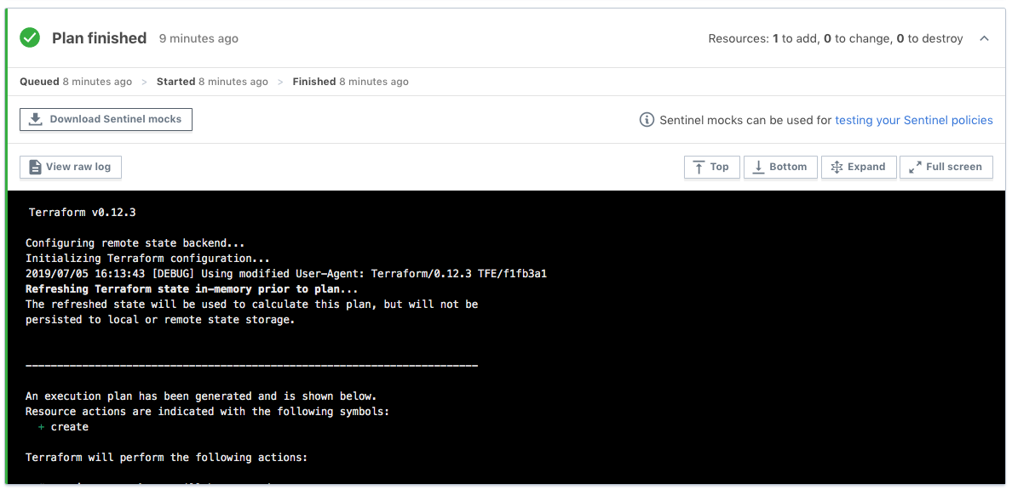
Generate Mocks Against Your Plan
Click this button
Notes:
This screenshot shows how mocks can be generated and downloaded.

Slide 66
Writing Sentinel Policies for TFC/TFE
Sometimes, you might be asked to create a Sentinel policy to restrict particular things such as VMs or load balancers.
But you might not know the exact Terraform resources that implement these.
Fortunately, you can use the Terraform Provider documentation to identify resources that implement the things you want to restrict.
Each resource and data source has its own documentation page.
Looking at documentation from the underlying cloud service provider or other technology will also help.
For instance, you can determine valid values for VM size.
Notes:
Often, when someone asks you to write a Sentinel policy for Terraform, you might not know what resources to use
You might also not know what attributes the resources have or which ones to focus on.
You'll want to review the Terraform Provider documentation for the relevant provider.
Start your search for Terraform providers at https://registry.terraform.io/browse/providers.
After selecting a provider, you can filter for resources that match what you type.

Slide 67
Write a Terraform Sentinel Policy
The next set of slides walks you through a Sentinel policy called "restrict-ec2-instance-type.sentinel" that restricts the allowed sizes of AWS EC2 instances.
It breaks down the Sentinel code into smaller bites, clarifying what each section of the code is doing.
Notes:
Step 5 is to write a Sentinel policy.
Let's walk through one over several slides.

Slide 68
Sentinel Import Declarations
# Import tfplan-functions.sentinel with alias "plan"
import "tfplan-functions" as plan
Notes:
We need to import any standard imports and any TFE Sentinel imports (tfplan/v2, tfconfig/v2, tfstate/v2, and tfrun) before we can use them.
We also need to import any Sentinel Modules that contain functions we wish to call.
In this case, we are importing the "tfplan-functions.sentinel" module with an alias set to "plan".
Note that we do not need to import tfplan/v2 since it is imported by the tfplan-functions module.

Slide 69
List of Allowed Values
# Allowed EC2 Instance Types
allowed_types = ["t2.small", "t2.medium", "t2.large"]
Notes:
We give a list of allowed EC2 instance types.
A list contains multiple items separated by commas.
If the closing bracket is on a line by itself, then the last item must have a comma after it.
If you put the closing bracket on the same line as the last item, you should leave out the final comma.

Slide 70
Call Sentinel Functions to Find and Filter Resources
# Get all EC2 instances
allEC2Instances = plan.find_resources("aws_instance")
# Filter to EC2 instances with violations
# The called function prints warnings for all violations
violatingEC2Instances = plan.filter_attribute_not_in_list(
allEC2Instances, "instance_type", allowed_types, true)
Notes:
We call the custom find_resources() function to find all EC2 instances
We then call the custom filter_attribute_not_in_list() function to filter to those EC2 instances that do not have "instance_type" set to a value in the allowed_types list.
Note that the second function prints a message for each EC2 instance that is selected by the filter. This is true of all the filter functions.
Both functions come from the tfplan-functions module that we aliased with "plan".
Recall that attributes include arguments and exported attributes.

Slide 71
Calculate Boolean and Check it in Main Rule
# Count violations
# We determine length of the messages map within the
# violatingEC2Instances object
violations = length(violatingEC2Instances["messages"])
# Main rule
main = rule {
violations is 0
}
Notes:
We set a boolean variable, violations, to the length of the violatingEC2Instances list.
The main rule will pass if violations is 0 but fail if it is not 0.
We prefer to always have a single main rule that only evaluates one or more boolean variables that have already been computed.
Doing this suppresses most of Sentinel's default TRUE/FALSE output which is really aimed at the writers of Sentinel policies, not at the consumers of them who in TFC/TFE are the writers of Terraform code that violated the policies.
Instead, we rely upon calls to Sentinel's print() function done by the filter function.

Slide 72
Common Functions
The Instruqt track in this workshop embeds two Sentinel modules with many common functions that can be used in policies.
These are copies of the functions located here.
The policy we just examined called the following functions:
find_resources(type)
filter_attribute_not_in_list(resources, attr, allowed, prtmsg)
There are other find and filter functions in the above modules.
The filter functions print all violations if prtmsg is true.
Additionally, the filter functions call a very useful function:
evaluate_attribute(r, attribute)
Notes:
Step 6 is to set up test cases for use with the Sentinel CLI and then test your policy.
The Sentinel CLI is particular about the organization and names of directories for test cases.
We need to create a test directory under the directory containing policies.
We need to create directories for each policy under the test directory.

Slide 73
Function That Finds All Resources By Type
# Find all resources of a specific type from all modules
# Only include resources that are being created or updated
find_resources = func(type) {
resources = filter tfplan.resource_changes as address, rc {
rc.type is type and
rc.mode is "managed" and
(rc.change.actions contains "create" or
rc.change.actions contains "update" or
rc.change.actions contains "read" or
rc.change.actions contains "no-op")
}
return resources
}
Notes:
The 'find_resources' function from the 'tfplan-functions' module (that we aliased with "plan") finds all resources of a given type that are not being permanently deleted.
Note that this function actually uses Sentinel's 'filter' expression.
A data source is technically a read-only resource.
In fact, the `mode` of a resource in the resource_changes collection of the tfplan/v2 import is "managed" for resources and "data" for data sources.
There is also a 'find_datasources" function in the same module.
We could have used a single find_resources() function for both resources and data sources, but then we would have had to include a `mode` parameter in the declaration of the function and every time it was called.
There are similar functions in the tfstate-functions module.

Slide 74
Function That Filters Resources
filter_attribute_not_in_list = func(resources, attr, allowed, prtmsg) {
violators = {}
messages = {}
for resources as address, rc {
v = evaluate_attribute(rc, attr) else null
if v not in allowed {
message = to_string(address) + " has " + to_string(attr) + " with value " + to_string(v) +
" that is not in the allowed list: " + to_string(allowed)
violators[address] = rc
messages[address] = message
if prtmsg {
print(message)
}
} // end if
} // end for
return {"resources":violators,"messages":messages}
}
Notes:
This is the "filter_attribute_not_in_list" function called by the policy.
We've highlighted the important parts in red.
Note that it iterates over all resources passed to it and then calls the "evaluate_attribute" function against each one to determine its value, giving `null` if it is missing. (The actual function converts null to the string "null".)
It then checks if the value is in the list of allowed values.
If not, it adds it to the violators map which is what the function returns.

Slide 75
Function that Evaluates Attributes
The filter functions all call the evaluate_attribute() function that recursively calls itself to evaluate attributes that can be deeply nested inside a resource or data source.
This function has the following declaration:
evaluate_attribute = func(r, attribute)
The resource passed to the first call to the function should be in the form rc.change.after or just rc where rc is a resource change derived by applying filters to tfplan.resource_changes.
The attribute should be given as a string delimited by "." in which indices of lists start with 0: "storage_os_disk.0.managed_disk_type".
Do not use something like "storage_os_disk[0].managed_disk_type".
Notes:
The evaluate_attribute function is very important.
It is called by all the filter functions.
There are actually versions of this in both the tfplan-functions and the tfstate-functions modules. Also in the tfconfig-functions module.
It is important to pass parameters to it in the forms it expects.
For the tfplan-functions version, pass r as `rc.change.after` in first call where rc is derived by applying filters to `tfplan.resource_changes `.
For the tfstate-functions version, pass r as `r.values` in the first call where r is derived by applying filters to `tfstate.resources`.
Pass `attribute` as a string delimited by "." in which indices of lists start with 0.
Do not use `[n]` notation for indices even though this is what you would use if working with a list directly.

Slide 76
Set Up the Test Cases Directory for the CLI
To test your policy with the Sentinel CLI, you first need to set up test cases that use the tfplan/v2 mock you generated earlier.
Under the directory containing your policy, create a test directory.
Under the test directory, create a directory with the same name as your policy, but without the ".sentinel" extension.
So, for our restrict-ec2-instance-type.sentinel policy, we create the restrict-ec2-instance-type directory under the test directory.
Notes:
Step 6 is to set up test cases for use with the Sentinel CLI and then test your policy.
The Sentinel CLI is particular about the organization and names of directories for test cases.
We need to create a test directory under the directory containing policies.
We need to create directories for each policy under the test directory.

Slide 77
Copy Mocks and Create Test Cases
Copy the mock-tfplan-v2.sentinel mock file that you downloaded and extracted from your workspace to this directory.
Change the name of the mock file to mock-tfplan-pass.sentinel.
Create a second copy of the file called mock-tfplan-fail.sentinel.
Create pass.hcl and fail.hcl files that have the text on the next two slides respectively.
Notes:
We are creating two test cases: one that will pass and one that will fail.
Each will have its own copy of the mock file that was generated from our plan.
But we will edit those mocks to have different values of the attribute we are testing.
If using tfconfig/v2, tfstate/v2, or tfrun mock files, you need to specify the mock type accordingly (instead of using "tfplan/v2").

Slide 78
The pass.hcl Test Case
module "tfplan-functions" {
source = "../../../common-functions/tfplan-functions/tfplan-functions.sentinel"
}
mock "tfplan/v2" {
module {
source = "mock-tfplan-pass.sentinel"
}
}
test {
rules = {
main = true
}
}
Notes:
The stanza at the top declares a Sentinel Module with functions that can be called by Sentinel policies that import them.
In this case, the file "tfplan-functions.sentinel" is being declared as the module "tfplan-functions". Recall that when we imported it in our policy, we gave it the alias "plan".
We also indicate that the test case should use the mock-tfplan-pass.sentinel mock and that the main rule should evaluate to true.
If using tfconfig/v2, tfstate/v2, or tfrun mock files, you need to specify the mock type accordingly (instead of using "tfplan/v2").

Slide 79
The fail.hcl Test Case
module "tfplan-functions" {
source = "../../../common-functions/tfplan-functions/tfplan-functions.sentinel"
}
mock "tfplan/v2" {
module {
source = "mock-tfplan-fail.sentinel"
}
}
test {
rules = {
main = false
}
}
Notes:
The fail.hcl test case declares the use of the same "tfplan-functions" Sentinel module.
But it uses the mock-tfplan-fail.sentinel mock and says that the main rule should evaluate to false.
This means that the fail test case will pass (and give green output) when the main rule returns false against mock-tfplan-fail.sentinel.
This can be confusing to new users of the Sentinel CLI since they expect the fail test case to fail and give red output.

Slide 80
Edit the Pass and Fail Mocks
Edit the mock-tfplan-pass.sentinel mock file and make sure that all values of instance_type are set to a value such as "t2.small" that is in the allowed_types list.
Edit the mock-tfplan-fail.sentinel mock file and make sure that at least one value of instance_type is set to a value such as "m5.large" that is not in the allowed_types list.
You should always have at least 1 fail and 1 pass test case.
Sometimes, you will want multiple fail test cases and corresponding mocks.
You might even want more than 1 pass test case and mock.
Notes:
You should always have at least one fail test case and one pass test case with corresponding mocks.
Sometimes you will want multiple fail test cases and corresponding mocks.
You might even want multiple pass test cases and corresponding mocks.

Slide 81
Test Your Policy with the CLI (1)
Now that you have set up your test cases, you can test your policy with the Sentinel CLI.
Navigate back to the directory containing your policy.
Run the following command:
sentinel test restrict-ec2-instance-type.sentinel
To see the outputs of the print statements, change this to:
sentinel test –verbose restrict-ec2-instance-type.sentinel
You can also apply a policy with the sentinel apply command, but you must set up a Sentinel configuration file like the "sentinel.json" file downloaded with the mocks or a "sentinel.hcl" file.
Notes:
We use the "sentinel test" command to test policies.
We can use the –run argument to indicate which policy we want to run, using a partial name or regex that suffices to uniquely identify the policy.
We can also specify the full policy name: "sentinel test restrict-ec2-instance-type.sentinel".
We use the –verbose argument to see output from print statements.
For using the sentinel apply command, see https://docs.hashicorp.com/sentinel/commands/apply
For Sentinel configuration files, see https://docs.hashicorp.com/sentinel/commands/config
Note that the zip file with the downloaded mocks actually contains a "sentinel.json" file which is a valid Sentinel configuration file, but you would want to edit it after moving the mocks into a different directory.

Slide 82
Test Your Policy with the CLI (2)
The first command gives:
PASS - restrict-ec2-instance-type.sentinel
PASS - test/restrict-ec2-instance-type/fail.hcl
PASS - test/restrict-ec2-instance-type/pass.hcl
The second command gives:
PASS - restrict-ec2-instance-type.sentinel
PASS - test/restrict-ec2-instance-type/fail.hcl
logs:
aws_instance.ubuntu[0] has instance_type t2.xlarge that is not in the allowed list:
["t2.small" "t2.medium" "t2.large"]
restrict-ec2-instance-type.sentinel:24:1 - Rule "main
Description: Main rule Value: false
PASS - test/restrict-ec2-instance-type/pass.json
restrict-ec2-instance-type.sentinel:24:1 - Rule "main
Description: Main rule Value: true
Notes:
We have condensed the output for the verbose option a bit.
We emphasize again that the fail.hcl test case passes and has green output even though the main rule for it returned false.
This is by design. All test cases should be configured to pass.
Step 7 is to revise your policy and test cases until the latter all pass
Step 8 is to deploy your policy to TFE organizations

Slide 83
Using Sentinel in Terraform Cloud and Terraform Enterprise
Notes:
While we won't be using Sentinel in Terraform Cloud or Terraform Enterprise today, we did want to review this topic
After all, that is where your Sentinel policies will really be running.
You'll get a chance to complete and test some more Sentinel policies with the Sentinel CLI after this section.

Slide 84
Testing Policies in Terraform Cloud
After successfully testing a policy with the CLI, you might also want to test it against actual Terraform code on a TFC or TFE server.
When doing this, we suggest you follow these recommendations:
Put each new policy in a policy set that does not contain any other policies.
Assign the workspaces you will be using to test your policy to that policy set.
Do not assign any other workspaces to the policy set.
Set the policy enforcement level to hard mandatory.
Following these recommendations will make your testing easier:
You won't see results from other policies.
You won't have to worry about overriding soft-mandatory failures.
Notes:
After testing new Sentinel policies with the Sentinel CLI, you can test them in an organization on a TFC or TFE server.

Slide 85
Creating Policy Sets with Policies
Policy Sets are created in a VCS repository.
Each policy set contains the policies and a configuration file called "sentinel.hcl" that lists the policies and their enforcement levels.
The "sentinel.hcl" file can also specify Sentinel modules to load.
Policies and Modules can be in any directory of the current repository and even in remote repositories.
You then configure the policy set in the Terraform Cloud UI by registering it, indicating the repository, branch, and policies path.
You can specify Parameters for it including sensitive ones.
You determine the workspaces it should be enforced on.
Notes:
You'll need to create policy sets that contain the policies you want to use in TFC or TFE
You can now specify Sentinel modules in your policy sets.
References to policies and modules in the same repository can use `..` to point to files outside the directory containing sentinel.hcl
Policies and Sentinel modules can be loaded from remote repositories using URLs that point to the raw files.

Slide 86
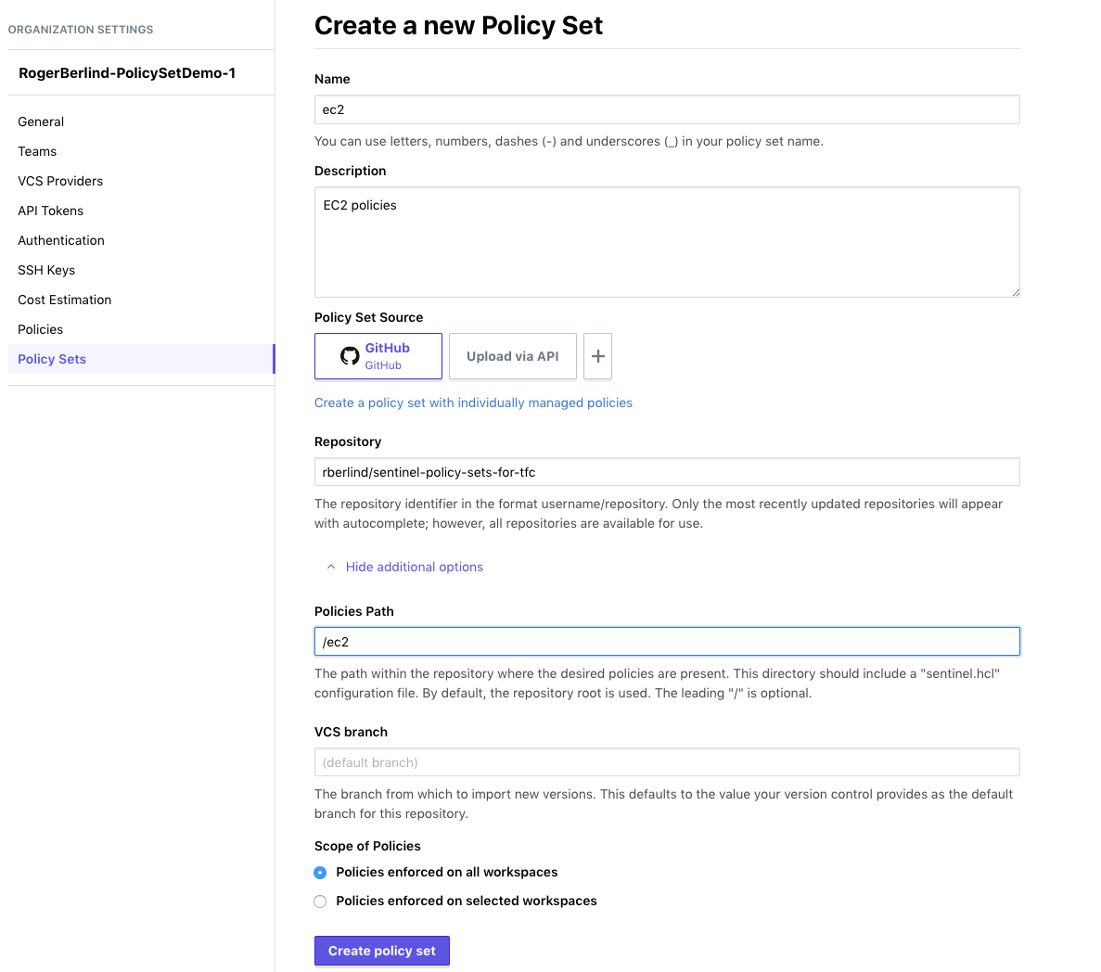
Notes:
This screenshot shows a VCS-backed policy set being registered in a TFC organization.

Slide 87
Example Policy Set
Here is an example policy set:
module "tfplan-functions" {
source = "../common-functions/tfplan-functions/tfplan
-functions.sentinel"
}
policy "restrict-ec2-instance-type" {
source = "./restrict-ec2-instance-type.sentinel"
enforcement_level = "soft-mandatory"
}
Notes:
You'll need to create policy sets that contain the policies you want to use in TFC or TFE
You can now specify Sentinel modules in your policy sets, but the modules must be in or under the directory with the sentinel.hcl file at this time.
In the near future, we will support loading of modules from remote locations.

Slide 88
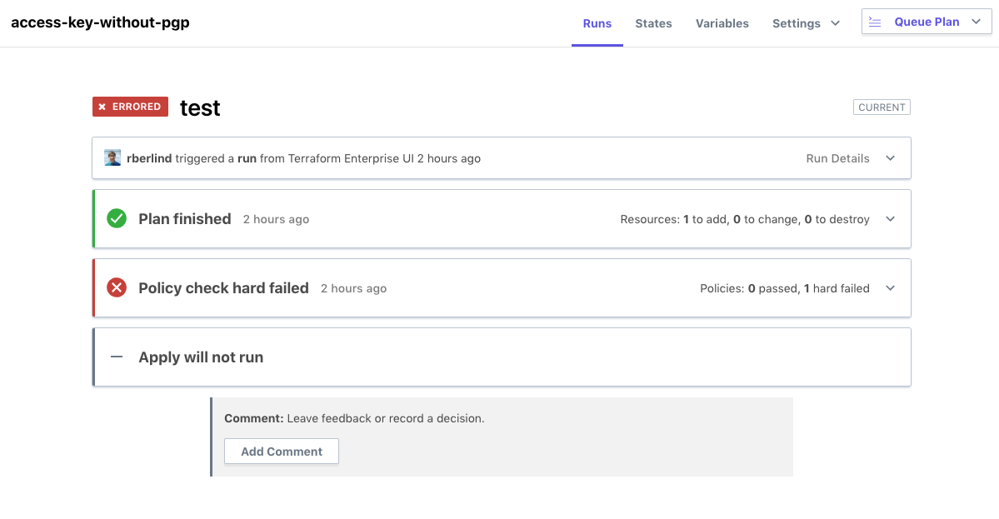
Sentinel Policy that Fails
Notes:
This screenshot shows a Sentinel policy check failing during a run in a TFC workspace.

Slide 89
Sentinel Policy that Fails
## Policy 1: terraform-guides-aws/restrict-ec2-instance-type (hard-mandatory)
Result: false
Description: This policy uses the Sentinel tfplan/v2 import to require that
all EC2 instances have instance types from an allowed list
Print messages:
aws_instance.this has instance_type t2.micro that is not in the allowed list ["t2.small" "t2.medium" "t2.large"]
restrict-ec2-instance-type.sentinel:24:1 - Rule "main
Description: Main rule
Value: false
Notes:
This screenshot shows more details of a Sentinel policy failing during a run in a TFC workspace.
Note that json output from Sentinel policies can be viewed and filtered.

Slide 90
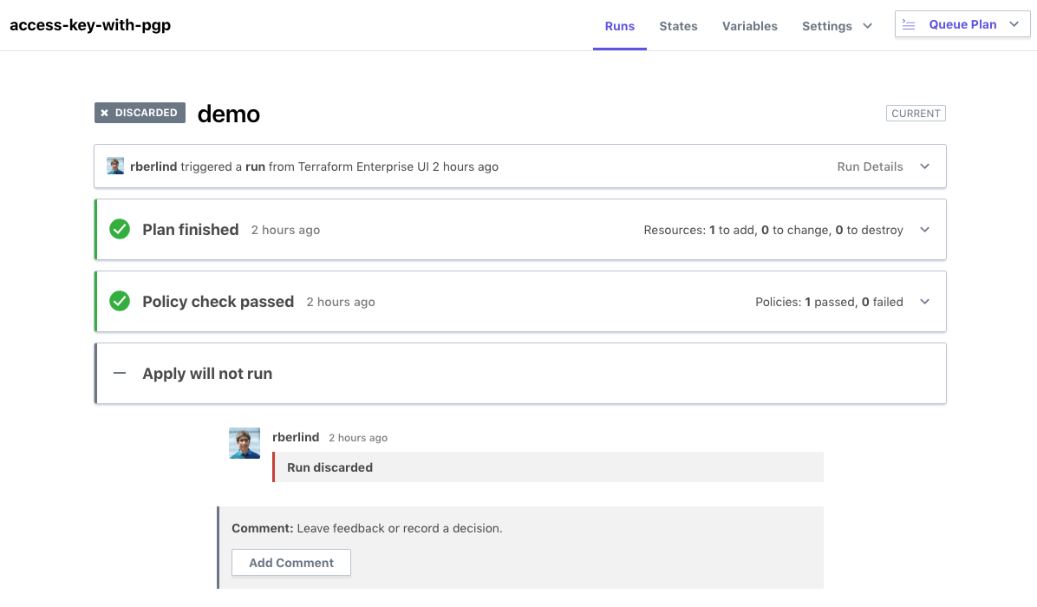
Sentinel Policy that Passes
Notes:
This screenshot shows a Sentinel policy check passing during a run in a TFC workspace.

Slide 91
Sentinel Policy that Passes
## Policy 1: terraform-guides-aws/restrict-ec2-instance-type (hard-mandatory)
Result: true
Description: This policy uses the Sentinel tfplan/v2 import to require that
all EC2 instances have instance types from an allowed list
restrict-ec2-instance-type.sentinel:24:1 - Rule "main
Description: Main rule
Value: false
Notes:
This screenshot shows more details of a Sentinel policy passing during a run in a TFC workspace.

Slide 92
Deploying Policies in Terraform Cloud
After successfully testing a policy with the CLI and possibly also on TFC itself, you will want to deploy it to your TFC organizations.
If you have not already added the policy to a policy set in your organizations, do that at this time.
Add the new policy to an existing policy set that is already applied against desired workspaces, or create a new policy set for the policy and apply that policy set to desired workspaces across your organizations.
Also add any parameters the policy requires to your policy set.
And add references to any Sentinel Modules that policies in it use.
Notes:
After testing a policy with the Sentinel CLI and possibly in a TFC/TFE organization, you'll want to deploy it to your TFC organizations.

